Slide 1

Negotiation and Persuasion

Slide 2


Negotiations are crucial elements of interpersonal communication both in our everyday and in our professional lives.
At the same time, negotiating in a persuading manner is one of the greatest challenges of interpersonal communication.
The purpose of a negotiation is always to reach a personal or a shared objective, to agree to some form of cooperation, or to resolve a conflict.
What is Negotiation

Slide 3
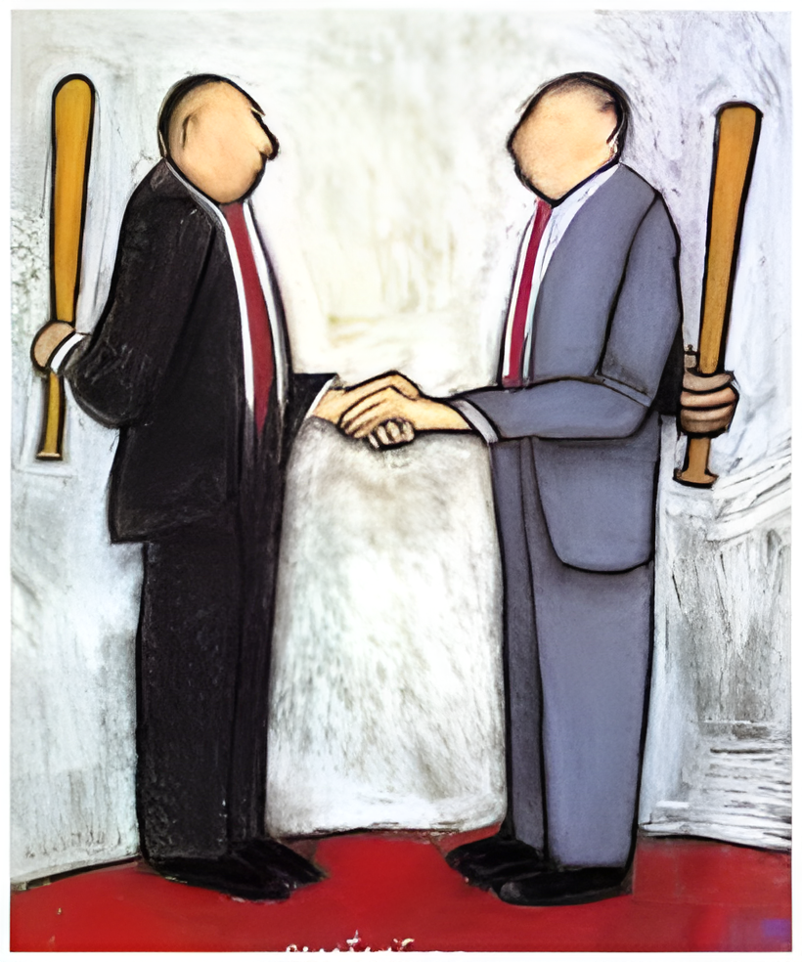
In order to achieve a desirable outcome, it may be useful to follow a structured approach to negotiation. For example, in a work situation a meeting may need to be arranged in which all parties involved can come together.
Preparation
Clarification of goals
Agreement
Stages of Negotiation
The process of negotiation includes:
Discussion
Negotiate towards a Win-Win outcome
Implementation of a course of action

Slide 4
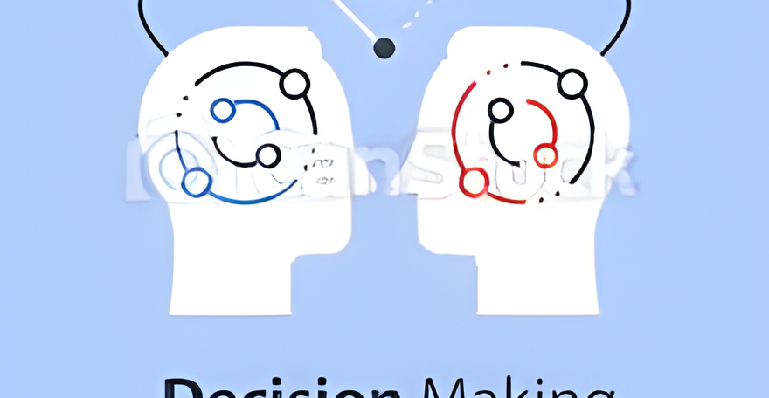

During this stage, individuals or members of each side put forward the case as they see it, i.e. their understanding of the situation.
Discussion

Slide 5

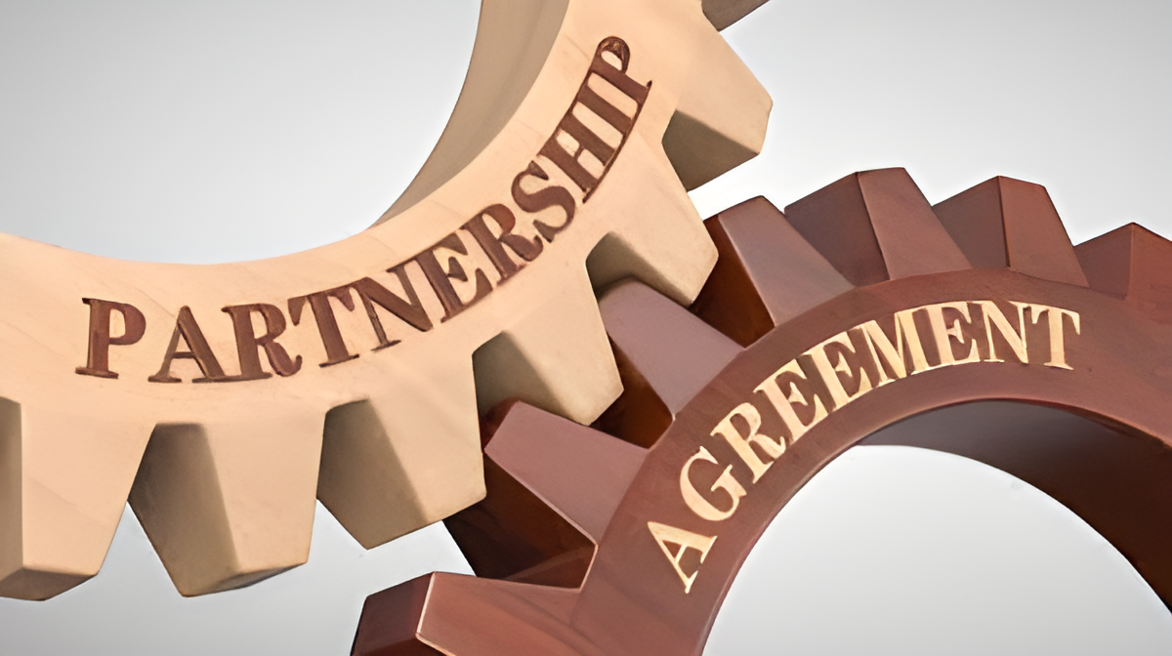


Slide 6
Reciprocity:Reciprocity is a process of exchanging things with other people to gain a mutual benefit
Authority:If one believes that a person or other entity has expert knowledge, one may be more likely to be persuaded by their message.
Social Proof: It is a psychological effect that leads us to copy other people’s behaviour. It has become an important part of how businesses communicate because it helps people choose who and what to trust online.
6 Principles of Persuasion
Scarcity: One might be persuaded to change one’s behavior if he/she is convinced that he/she will lose access to something, or that there isn't enough of it to go around.
Consistency or Commitment:It describes the way in which people want their beliefs and behaviours to be consistent with their values and self-image.
Liking:Persuasion by reciprocation is based on the law of reciprocity. It’s considered by many to be the most powerful law of human nature. Basically, it states that, "If you do something nice for me I’ll do something nice for you. I feel obligated to reciprocate.”

Slide 7

Understand the other party’s needs and motivations: Before entering a negotiation, it’s essential to understand what the other party hopes to achieve and their priorities. By doing so, you can tailor your approach and proposals to meet their needs better, making it more likely for them to agree to your terms.
How to become better at negotiation?
Focus on creating win-win outcomes: Effective negotiation isn’t about dominating or overpowering the other party but finding a mutually beneficial solution. Look for ways to create value for both parties and aim for a compromise that satisfies everyone’s needs.

Slide 8
Develop strong communication skills: Communication is critical in any negotiation, so it’s important to practice active listening, clarify your understanding, and express your ideas clearly and persuasively. Avoid making assumptions and seek to understand the other party’s perspective before making your points.
Be willing to walk away: Sometimes, reaching a mutually beneficial agreement may not be possible, and knowing when to walk away is essential. You can avoid getting stuck in a flawed agreement by being prepared to leave a deal that isn’t in your best interest.
Prepare thoroughly: Negotiation requires preparation and planning, so gather all the relevant information and data before entering a discussion. Anticipate potential objections or challenges and develop counterarguments and alternatives in advance.

Slide 9
Use evidence and data: Persuasion is more effective when backed up by evidence and factual details. Use facts, statistics, and research to support your argument and provide concrete examples to illustrate your points.
Be open to feedback and adjust your approach: Persuasion is an iterative process, and it’s essential to be available for feedback and adapt your strategy as needed. Listen to objections and concerns and be willing to modify your proposal or approach to meet the needs of your audience better.
Cont…

Slide 10
Conclusion !
Persuasion is useful when you want someone to see your point of view convincingly, and negotiation is beneficial when both parties wish to arrive at a win-win outcome.
In conclusion, it’s essential to understand that persuasion and negotiation go hand-in-hand when managing people and situations.
The ability to convince people and arrive at a mutually agreeable outcome makes a manager’s job easier.

